Slide 1


cOptimism
Notes:
The 2020 Call for Code Challenge encourages developers and problem solvers of all different backgrounds to answer the call and solve some of the worlds most pressing issues. The United Nations is demanding a global reality check, and that’s why we need you.

Slide 2


Call for Code 2020, COVID-19 Accelerated Program
Ranjan Patro ranjan.patro@capgemini.com
Aftab, Tabish tabish.aftab@capgemini.com
Chatradi, Devi devi.a.devi@capgemini.com

Slide 3
CHALLENGE
This pandemic calls for Social Distancing/Quarantine, whether it is Self-imposed or imposed by the Governing bodies.
In such case, the main concern of common public is how to get essentials, like groceries, medicine, food, etc.
Solution:
Our solution bridges the business, customers, and delivery associates by capturing and sharing the info by different parties.
Advantage:
Different parties provide information, thus forming a Local News Pool.
They provide their travel details (to stores or within and outside City, State, Country) and infection status, along with other information like date & time.
This is stored and cascaded to other users in proximity of the infected and other possible people around them and generates a hot spot warning too.
Notes:
A description of the problem statement you are trying to resolve.

Slide 4
EMPATHY MAPS
Need: | Help others, help yourself: | How:
Stores need help with business from local people. | Stores share the information about their store location, open and close time, items available, stock status, freshness status. | Via Chatbot, etc.
Customers need help to find which stores are open. | Since not all stores can provide info, Customers can share their experience, which will help other customers find out about stores | Via Chatbot, etc.
Some Customers need help with delivery of the stuff too. | Customers can request Stores/Delivery Associate for door delivery. Stores/Delivery Associate can coordinate with Customers and deliver the items. | Via Chatbot, etc.
Stores/ Customers/ Delivery Associate want to know if they might be Covid infected. | Stores/ Customers/ Delivery Associate provide their travel details (to stores or within and outside City, State, Country) along with other information like date and time, and infection status. | Via Notification.
Notes:
Add your digital empathy maps here
Duplicate this slide as needed

Slide 5
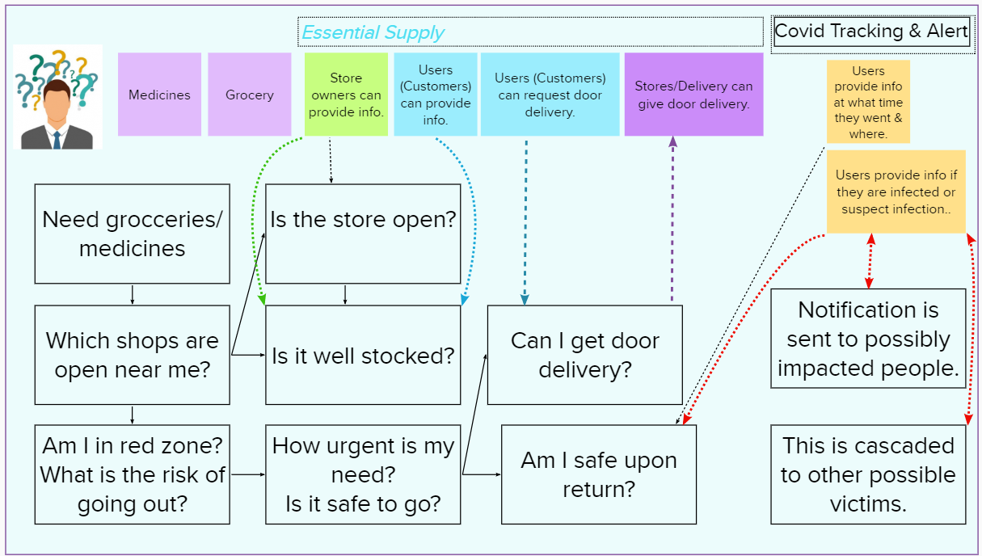
STORY BOARDS
Notes:
Depict the journey of the persona

Slide 6



TECHNOLOGY SUGGESTIONS
SpeechTo Text
Watson Assistant
Cloud
Functions
Cloudant DB
Hot Spot
Analysis
Text
To Speech
Web
Hooks
Mass
Notification
Proximity
Notification
Covid
Notification
Notes:
A raw list of technology that can be used to implement the solution, as well as alternatives. Mention any base code pattern, IBM Cloud service offerings, open source technologies, infrastructure etc.

Slide 7
SOLUTION APPROACH
Information Contribute
Customer
Business
Owner
Information Contribute
Information
Request
Cloudant DB
Covid Vulnerable
Covid Vulnerable
Information Contribute
Delivery
Associate
Covid Vulnerable
Watson Assistant
 
Notification
Notes:
Describe the approach of resolving the challenge identified & the outcomes

Slide 8
HIGH LEVEL ARCHITECTURE
Contribute/Get Help
Backend
Get Notified
Mike

Speech
To Text
Chatbot
Web
Hooks
Alerts
Speaker

Text to Speech
Cloud
Functions
Covid
Notifications
Cloudant
DB
Hot Spot
Analysis
Notes:
Add architecture diagrams as applicable, e.g. – overall architecture, sequence, deployment etc.

Slide 9
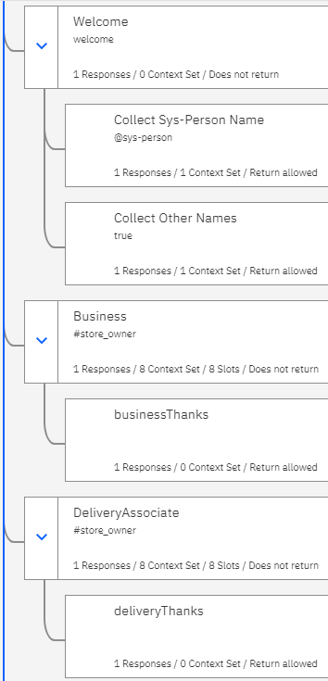
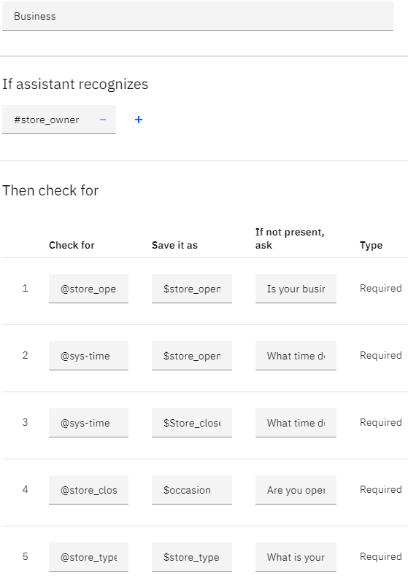
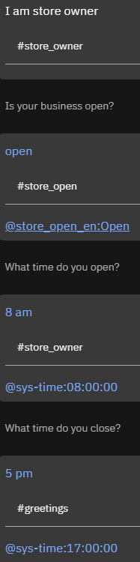
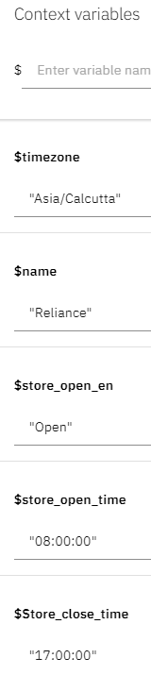
SOURCE CODE Business Setups
Notes:
Add GIT link

Slide 10
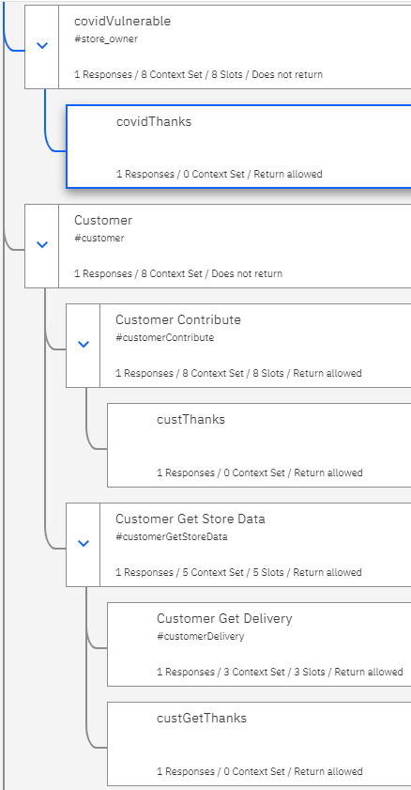
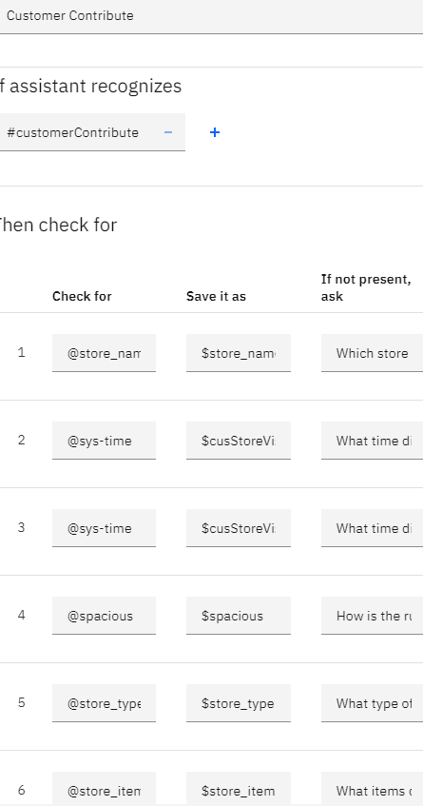
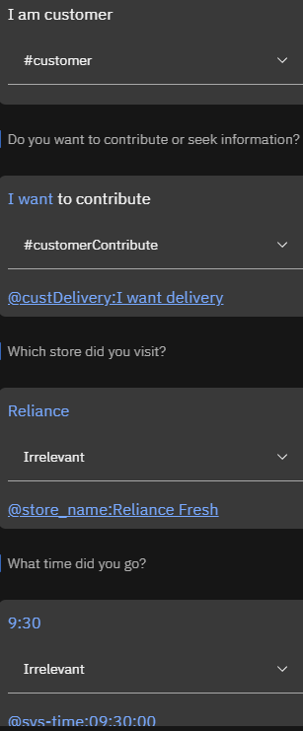
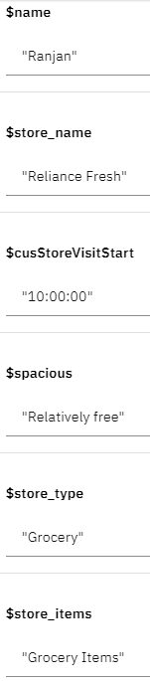
SOURCE CODE Customer Contribution Setups
Notes:
Add GIT link

Slide 11
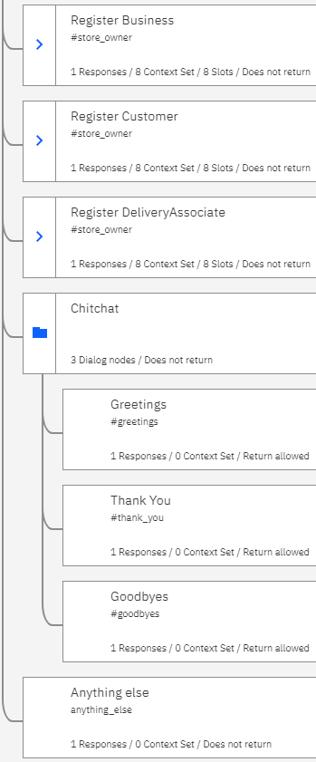
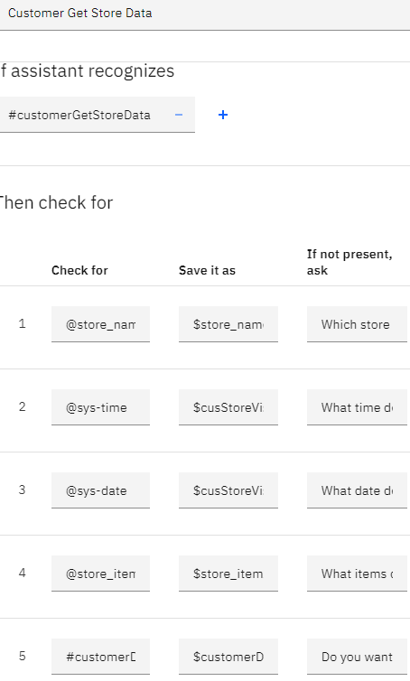
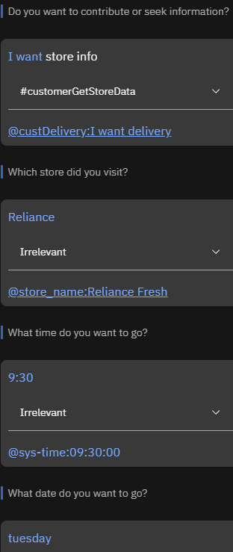
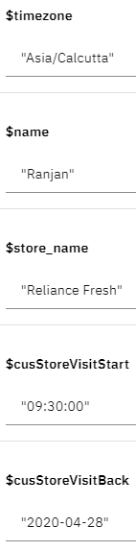
SOURCE CODE Customer Request
Notes:
Add GIT link

Slide 12
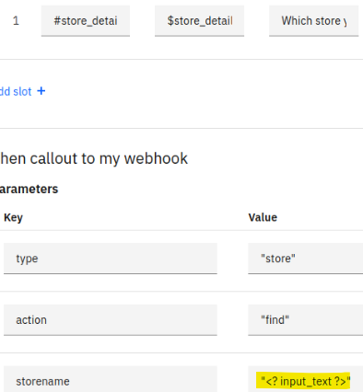
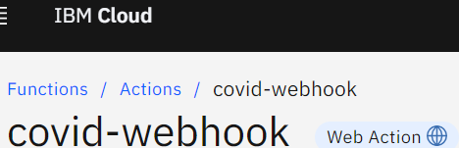
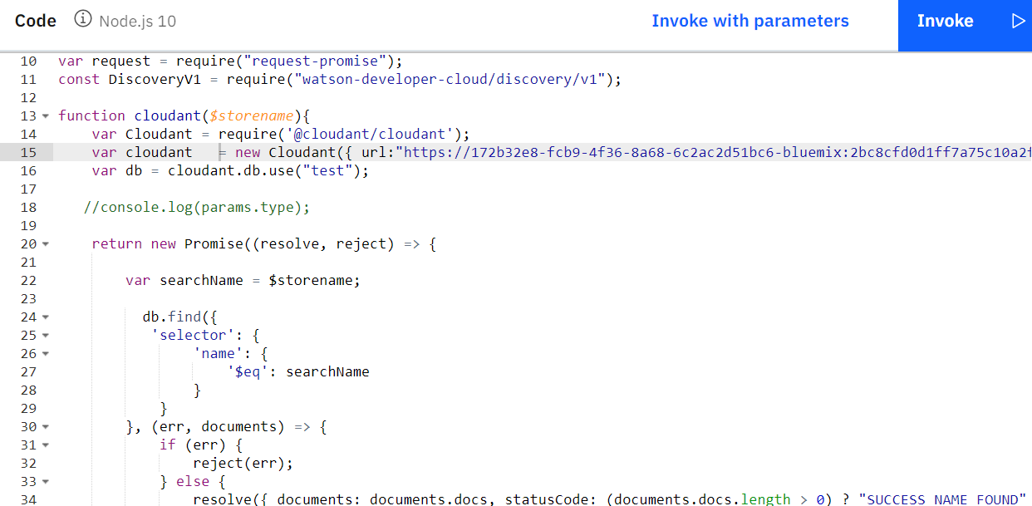
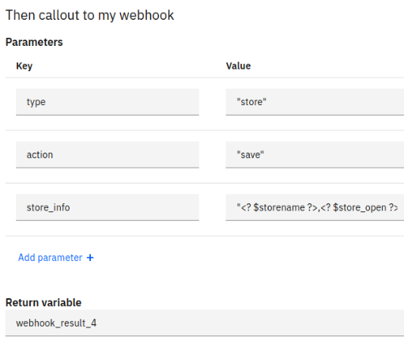
SOURCE CODE Watson Assistant and Node.js
Notes:
Add GIT link

Slide 13
Phases
Current | Future
We have used Inputs from store Inputs from/Requests to Customer Inputs from Delivery Associate | We want to Create Proximity and Mass Notifications Provide Map for Direction Hot Spot Representation Use Translator for global usability. Help Stores(/Visa/Mastercard, etc) notify their customers by using their customer database.
We have integrated (technically) Chatbot Node Js Cloudant DB Slakbot | We plan to integrate (technically) Speech to text, Text to speech, Translator Maps Facebook Messenger
Notes:
Add GIT link

Slide 14

Short Video (2-3 minutes)/Code
Youtube:
https://www.youtube.com/watch?v=XvC1x9Oha3U&list=PLJZ7tzQf5MniXdkKLFV9uJWJue-XD4dlz https://youtu.be/XvC1x9Oha3U
Github:
https://github.com/patror-pstech/cOptimism-Call4Code2020-COVID19
App Box:
https://app.box.com/s/rfefo5k79dbqg2cio499jn9r2j1ahv22
Notes:
Add GIT link

